Slide 1
Demand Analysis
Demand and Revenue
Management 405
Prof. Clemence Tricaud · UCLA Anderson

Slide 2
Demand Analysis · Outline
Outline
1
The Law of Demand
When price falls, quantity demanded rises — holding all else constant
2
Elasticities
How responsive demand is to own price, income, and competitors' prices
3
Demand and Revenue
How own-price elasticity drives total revenue, and how to find marginal revenue
4
Demand Estimation
Measuring demand through market experiments and regression analysis
Management 405 · Demand Analysis
2

Slide 3
Demand Analysis · Demand and Revenue
Outline
1
The Law of Demand
When price falls, quantity demanded rises — holding all else constant
2
Elasticities
How responsive demand is to own price, income, and competitors' prices
3
Demand and Revenue
How own-price elasticity drives total revenue, and how to find marginal revenue
4
Demand Estimation
Measuring demand through market experiments and regression analysis
Management 405 · Demand Analysis
3

Slide 4
Demand Analysis · Demand and Revenue
Plotting the Demand Curve
Note: this is the demand function a single firm faces
P
$400
Demand function
Q = 1,600 − 4P
Inverse demand function
P = 400 − Q/4
D
1600
Q
Management 405 · Demand Analysis
4

Slide 5
Demand Analysis · Demand and Revenue
From Demand to Total Revenue
P
$400
Demand: Q = 1,600 − 4P
Inverse demand: P = 400 − Q/4
Total revenue: TR = P · Q
Plug in for P:
TR = (400 − Q/4) · Q
= 400Q − Q²/4
200
Total revenue
D
TR
800
1600
Q
$160,000
800
1600
Q
Management 405 · Demand Analysis
5

Slide 6
Demand Analysis · Elasticity and Revenue
Effect of a Price Change on Total Revenue
P
Reduction in TR from a lower price
Increase in TR from higher volume
P₀
P₁
Demand
Which is bigger?
TR
Q₀
Q₁
Q
Management 405 · Demand Analysis
6

Slide 7
Demand Analysis · Elasticity and Revenue
Effect of a Price Change on Total Revenue: It Depends on E_{d}
P
E_{D} < −1 elastic
E_{D} = −1
−1 < E_{D} < 0 inelastic
D
Q
TR
Q
Management 405 · Demand Analysis
7

Slide 8
Demand Analysis · Elasticity and Revenue
To Assess a Price Change, Ask About Elasticity
To assess the effect of a price decrease on revenue, ask:
Is the price reduction relatively LARGER than the rise in quantity sold? (demand inelastic)
→ Total revenue declines
Is the price reduction relatively SMALLER than the rise in quantity sold? (demand elastic)
→ Total revenue rises
Management 405 · Demand Analysis
8

Slide 9
Demand Analysis · Elasticity and Revenue
Price Changes and Revenue: The Four Cases
% change in P | Resulting % change in Q | Demand is… | Change in revenue
If P decreases | Q increases by MORE than P falls | Elastic | Revenue increases
If P decreases | Q increases by LESS than P falls | Inelastic | Revenue decreases
If P increases | Q decreases by MORE than P rises | Elastic | Revenue decreases
If P increases | Q decreases by LESS than P rises | Inelastic | Revenue increases
Management 405 · Demand Analysis
9

Slide 10

Demand Analysis · Elasticity and Revenue
Does a Price Cut Raise Revenue?
Novo Nordisk lowered its U.S. price for Ozempic and Wegovy under a deal with the White House
As a result, sales are forecasted to fall 5–13%
What does this imply about the elasticity of demand?
Source: Pharmaceutical Technology
Poll break
Management 405 · Demand Analysis
10

Slide 11
Demand Analysis · Elasticity and Revenue
Poll: Is Demand Elastic or Inelastic?
Demand is:
Elastic
A
Inelastic
B
Unit elastic
C
Not enough information
D
Management 405 · Demand Analysis
11

Slide 12
Demand Analysis · Elasticity and Revenue
Poll Results
Demand is:
Elastic
0%
Inelastic
0%
Unit elastic
0%
Not enough information
0%
Management 405 · Demand Analysis
12

Slide 13
Demand Analysis · Elasticity and Revenue
Solution
Demand is
inelastic
A price cut caused total revenue to fall
The quantity response was too small to offset the price cut
Inelastic: |E_{D}| < 1
Management 405 · Demand Analysis
13

Slide 14
Demand Analysis · Elasticity and Revenue
What About Profits?
Profit = Revenue − Costs
The price decrease caused total revenue to decrease
It also raised the quantity produced/sold → costs increase
So profits fell
Markets agreed: Novo Nordisk shares tumbled ~18%
Management 405 · Demand Analysis
14

Slide 15
Demand Analysis · Elasticity and Revenue
Elasticity and Pricing
Firms should not operate on the inelastic part of demand
With inelastic demand, quantity reacts little, so raising price raises revenue
Quantity also falls, so variable costs fall
So firms can raise profits by raising prices
Example: a 2016 study put Uber's elasticity at −0.4 (inelastic); it raised prices ~18%/yr (2018–2022) and revenue rose
With elastic demand, raising price lowers revenue and costs — the effect on profit is ambiguous
Management 405 · Demand Analysis
15

Slide 16

Demand Analysis · Elasticity and Revenue
The Netflix 2014 Price Increase
In 2014, Netflix raised its monthly price by $1, from $7.99 to $8.99
Then: 50 million subscribers, own-price elasticity of demand ≈ −2
Implications of the price increase for:
Number of subscriptions (quantitative)? Revenue (qualitative)?
Profits (speculative)?
Group discussion
Management 405 · Demand Analysis
16

Slide 17
Demand Analysis · Elasticity and Revenue
Solution: Netflix
Subscriptions decline — by how much? Use Method 1 with E_{D} = −2:
%ΔQ
%ΔQ
E_{D}
=
=
= −2
%ΔP
12.5%
where %ΔP = (8.99 − 7.99) / 7.99 = +12.5%, so %ΔQ = −25%
→ a 25% decline in subscriptions
Revenue: demand is elastic, so quantity outweighs price → revenue falls
Profits: fewer subscribers, near-zero cost savings → profits likely fell too
Management 405 · Demand Analysis
17

Slide 18
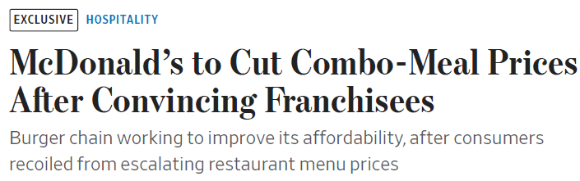
Demand Analysis · Elasticity and Revenue
Why Is McDonald's Cutting Prices?
What does this suggest about its demand?
How did it persuade franchisees to adopt the cuts?
What does this reveal about demand across locations?
What are the implications for revenue and profit given a franchise's E_{D}?
Management 405 · Demand Analysis
18

Slide 19

Demand Analysis · Elasticity and Revenue
Lottery Sales, Revisited
In 2024 the Massachusetts State Lottery raised ticket prices from $2 to $5
Weekly ticket sales fell from 142,170 to 100,297
We computed E_{D} = −0.2
Is the report right that revenue rises when the price went from $2 to $5?
Management 405 · Demand Analysis
19

Slide 20
Demand Analysis · Marginal Revenue
Outline
1
The Law of Demand
When price falls, quantity demanded rises — holding all else constant
2
Elasticities
How responsive demand is to own price, income, and competitors' prices
3
Demand and Revenue
How own-price elasticity drives total revenue, and how to find marginal revenue
4
Demand Estimation
Measuring demand through market experiments and regression analysis
Management 405 · Demand Analysis
20

Slide 21
Demand Analysis · Marginal Revenue
Why Do We Care About Marginal Revenue?
General objective: maximize net benefits
Use marginal analysis
Net benefits are maximized where MB = MC
Firms' objective: maximize profits
Produce where Marginal Revenue (MR) = Marginal Cost (MC)
Today: how to compute MR
Management 405 · Demand Analysis
21

Slide 22
Demand Analysis · Marginal Revenue
Marginal Revenue: Definition
Intuitively: the additional revenue from selling one more unit
Mathematically: how much total revenue changes when quantity sold increases by one unit
ΔTR
MR
=
ΔQ
How to compute MR: start from the demand function and use a 3-step method
Management 405 · Demand Analysis
22

Slide 23
Demand Analysis · Marginal Revenue
The 3-Step Method to Derive MR
1. Calculate inverse demand
Rearrange demand so P is a function of Q
2. Calculate total revenue
TR = P · Q; replace P with inverse demand so TR is a function of Q only
3. Calculate marginal revenue
Take the derivative of TR with respect to Q
Problem Set 2 · #4, #5 + Teaching Note: Marginal Revenue
Management 405 · Demand Analysis
23

Slide 24
Demand Analysis · Marginal Revenue
Calculus Refresher
ΔY
: the change in
Y
with respect to
X
ΔX
Suppose
Y = a + bX + cX²
ΔY
=
b + 2cX
ΔX
See also the “Math Prep” on BruinLearn and the math review in the textbook
Management 405 · Demand Analysis
24

Slide 25
Demand Analysis · Marginal Revenue
The 3-Step Method in Action
Suppose demand is
Q = 1,600 − 4P
1. Inverse demand (solve for P):
1
P = 400 −
Q
4
2. Total revenue TR = P · Q:
1
1
TR = (400 −
Q) · Q = 400 · Q −
Q²
4
4
3. Marginal revenue MR = ΔTR / ΔQ:
1
MR = 400 −
Q
/ 2 = 400 −
Q
2
Management 405 · Demand Analysis
25

Slide 26
Demand Analysis · Marginal Revenue
MR: Graphical Representation
P
400
Elastic portion
Q = 1,600 − 4P
P = 400 − Q/4
TR = 400Q − Q²/4
MR = 400 − Q/2
E_{D} = −1
MR
Inelastic portion
D
TR
800
1600
Q
TR
800
Q
Management 405 · Demand Analysis
26

Slide 27
Demand Analysis · Marginal Revenue
Why Is MR Different From the Price?
MR: the additional revenue from selling one more unit
Sounds like the price! But…
Law of demand: you must lower the price to sell one more unit
That lower price applies to all units, not just the extra one
The decision is not sequential
MR accounts for the loss on every other unit ⇒ MR < P
Management 405 · Demand Analysis
27

Slide 28
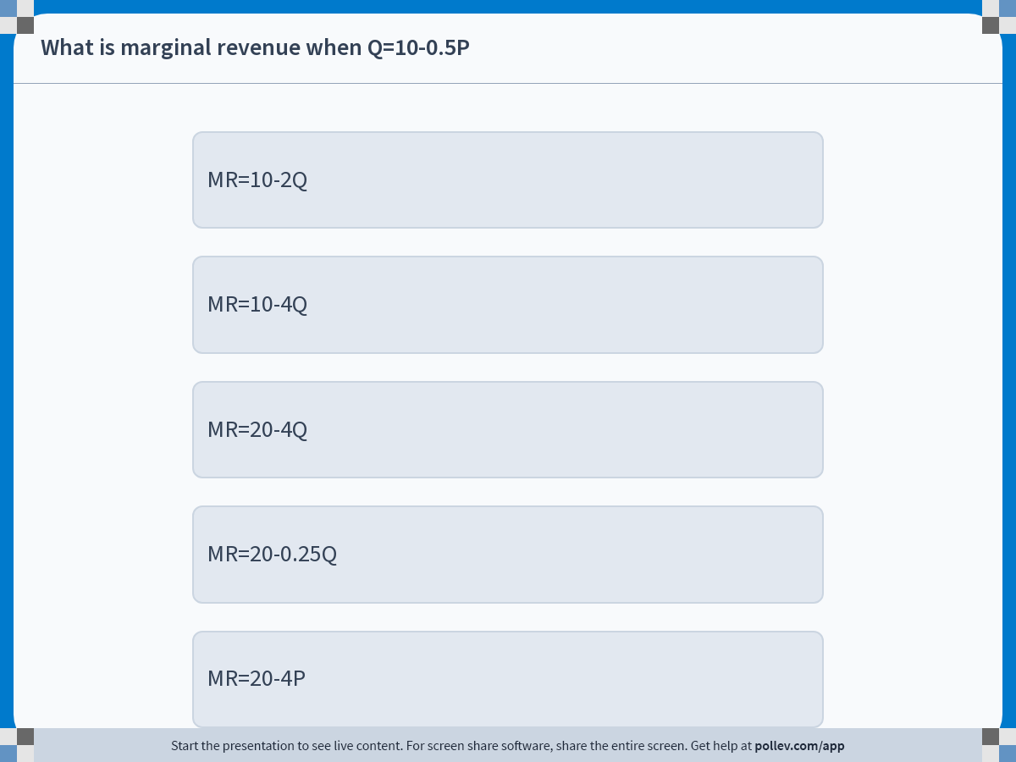
Demand Analysis · Marginal Revenue
Poll: What Is Marginal Revenue?
Management 405 · Demand Analysis
28

Slide 29
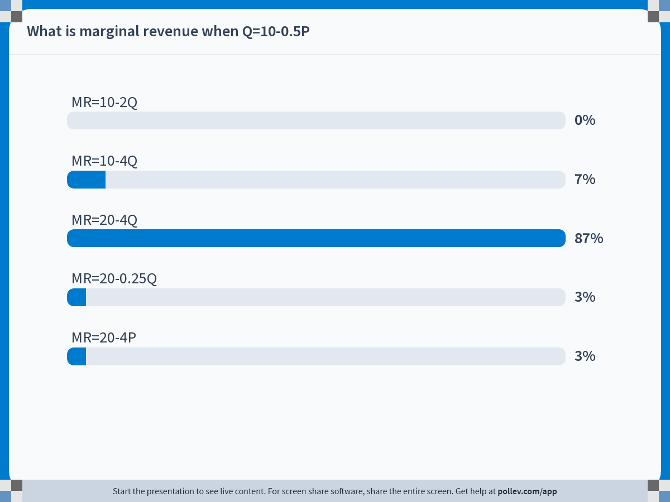
Demand Analysis · Marginal Revenue
Poll Results
Management 405 · Demand Analysis
29

Slide 30
Demand Analysis · Marginal Revenue
Solution: Deriving MR
If
Q = 10 − 0.5P
, what is
MR
?
1. Inverse demand:
P = 20 − 2Q
2. Total revenue:
TR = (20 − 2Q) · Q = 20Q − 2Q²
3. Derivative of TR w.r.t. Q:
MR = 20 − 4Q
Management 405 · Demand Analysis
30

Slide 31

Demand Analysis · Marginal Revenue
Inside Out 2's Marginal Revenue
Demand for streaming Inside Out 2 on Disney+ (Q: viewers, in millions)
1
Q = 20 −
P
2
What is the revenue-maximizing price?
Why might Disney care about revenue maximization?
Group discussion
Management 405 · Demand Analysis
31

Slide 32
Demand Analysis · Marginal Revenue
Solution: Inside Out 2's Revenue-Maximizing Price
Revenue is maximized where MR = 0. Compute MR using the 3-step method:
1. Inverse demand: P = 40 − 2Q
2. Total revenue: TR = 40Q − 2Q²
3. Derivative: MR = 40 − 4Q
Set MR = 0
40 − 4Q = 0 ⇒ Q = 10 ⇒ P = $20
Revenue is maximized for P = $20
Why might Disney care about revenue maximization?
Streaming: marginal cost ≈ 0
Profits are thus also maximized at MR = 0
Management 405 · Demand Analysis
32

Slide 33
Demand Analysis · Outline
Outline of Module 2
1
The Law of Demand
When price falls, quantity demanded rises — holding all else constant
2
Elasticities
How responsive demand is to own price, income, and competitors' prices
3
Demand and Revenue
How own-price elasticity drives total revenue, and marginal revenue
4
Demand Estimation
Measuring demand through market experiments and regression analysis
Management 405 · Demand Analysis
2

Slide 34
Demand Analysis · Demand Estimation
How to Estimate a Demand Curve?
Use regression analysis to estimate the relationship between price and quantity
Need data linking prices to quantities
Several approaches
Transaction data (marketing firms, internet, store club cards)
Surveys
Market experimentation
Management 405 · Demand Analysis
3

Slide 35

Demand Analysis · Demand Estimation
A/B Testing: What Is the Demand for This Product?
Management 405 · Demand Analysis
4

Slide 36
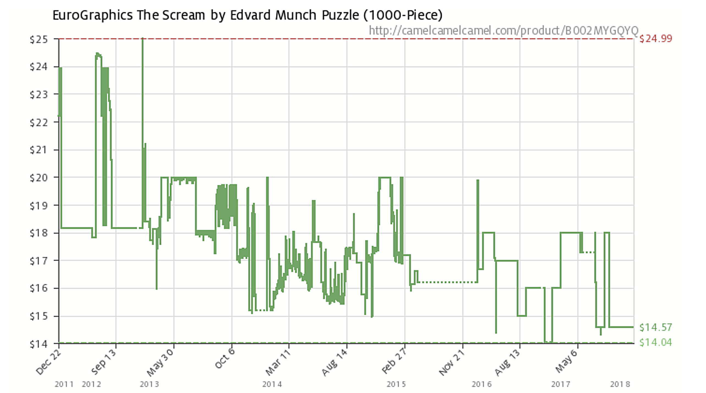
Demand Analysis · Demand Estimation
A/B Testing: Amazon “Experiments”
Management 405 · Demand Analysis
5

Slide 37

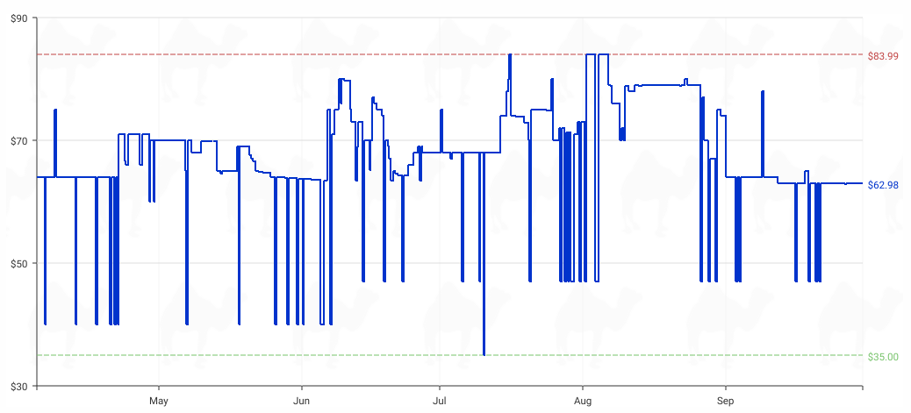
Demand Analysis · Demand Estimation
Recent Amazon “Experiments”
camelcamelcamel.com
Management 405 · Demand Analysis
6

Slide 38
Demand Analysis · Demand Estimation
Econometric Estimates
Description: combine economics, statistics, and mathematical model building
Develop hypotheses linking dependent variables (e.g., sales) to explanatory variables (e.g., price)
How: least squares regression analysis
Covered in detail in your Stats class
Today: a broad overview
What you need here: interpret and use the coefficients
Management 405 · Demand Analysis
7

Slide 39
Demand Analysis · Demand Estimation
Ordinary Least Squares: The Basic Equation
Q = a + b · P
Q = dependent variable
P = independent variable
a = intercept with the y-axis (Q on y-axis)
b = slope of the regression line (inverse of the usual demand slope)
ΔQ
P
P
E_{d}
=
·
=
b
·
ΔP
Q
Q
Management 405 · Demand Analysis
8

Slide 40

Demand Analysis · Demand Estimation
Airline Ticket Experimentation
Price ($) | Seats sold
250.00 | 64
265.00 | 33
265.00 | 37
240.00 | 83
230.00 | 111
225.00 | 137
225.00 | 109
220.00 | 96
230.00 | 59
235.00 | 83
245.00 | 90
240.00 | 105
250.00 | 75
240.00 | 91
240.00 | 112
235.00 | 102
Management 405 · Demand Analysis
9

Slide 41
Demand Analysis · Demand Estimation
First Pass: Eyeball the Relationship
Scatterplot of Q versus P
Quantity
150
100
50
220
240
260
Price ($)
Management 405 · Demand Analysis
10

Slide 42
Demand Analysis · Demand Estimation
Least Squares Estimation
Quantity
150
Least Squares Algorithm
1. Calculate all vertical distances
2. Square them
3. Sum them over all data points
4. Choose the line that minimizes the sum of squares
100
50
220
240
260
Price ($)
Management 405 · Demand Analysis
11

Slide 43
Demand Analysis · Demand Estimation
Regression Results
Coefficient | Value
Constant (intercept) | 478.95
Own price | −1.64
Q = 478.95 − 1.64 P
Now that we have demand, we can compute MR!
Management 405 · Demand Analysis
12

Slide 44
Demand Analysis · Demand Estimation
Multivariate Regression
Incorporating other determinants of demand
Q = a + b · P + c · P_{c} + d · Y
Q = amount purchased
P = own price
P_{c} = competitor's price
Y = income
Management 405 · Demand Analysis
13

Slide 45
Demand Analysis · Demand Estimation
Results With Added Variables
Coefficient | Value
Constant (intercept) | 26.70
Own price | −2.13
Competitor's price | 1.04
Income | 3.10
Q = 26.70 − 2.13 P + 1.04 P_{c} + 3.10 Y
Management 405 · Demand Analysis
14

Slide 46
Demand Analysis · Application
Application
Q = 478.95 − 1.64 P
Use the estimated airline demand to answer the polls
Poll break
Management 405 · Demand Analysis
15

Slide 47
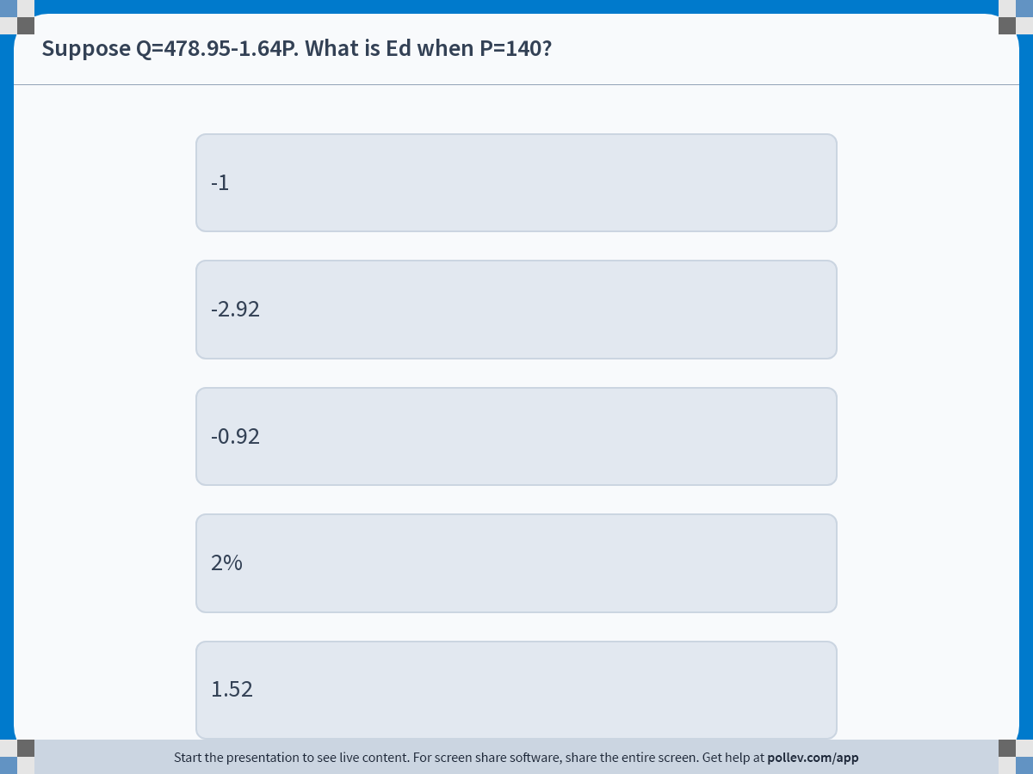
Demand Analysis · Application
Poll: What Is E_{d} at P = 140?
Management 405 · Demand Analysis
16

Slide 48
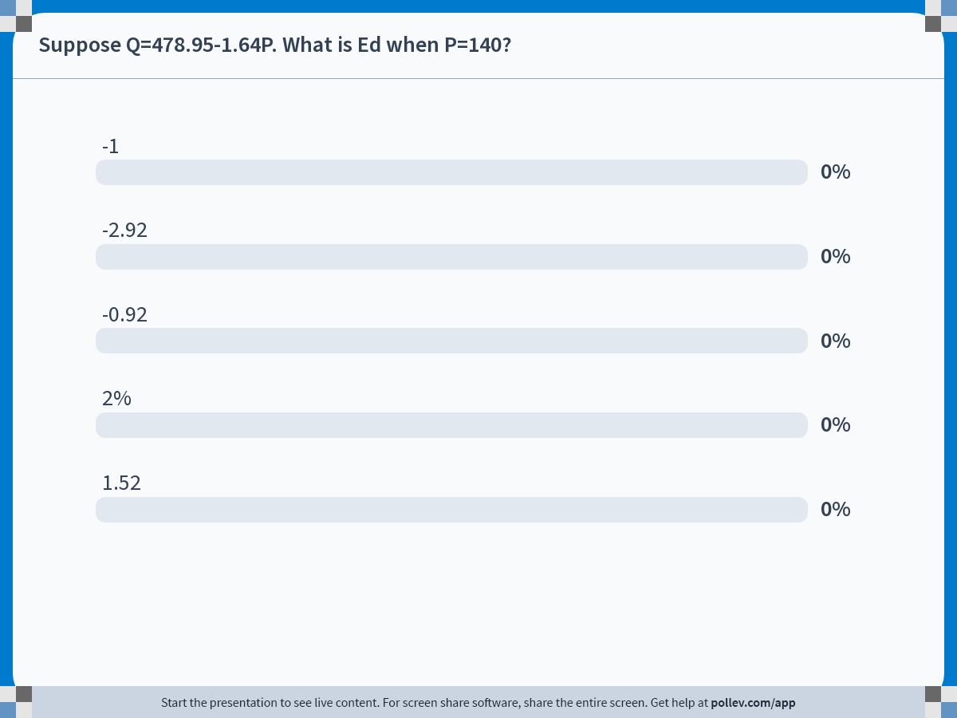
Demand Analysis · Application
Poll Results: Elasticity
Management 405 · Demand Analysis
17

Slide 49
Demand Analysis · Application
Solution: Eᴅ
Q = 478.95 − 1.64 P
Recall E_{d} = (ΔQ/ΔP) · (P/Q)
ΔQ/ΔP is the slope of demand ⇒ ΔQ/ΔP = −1.64
Plug P in to get Q: Q = 478.95 − 1.64 · 140 = 249.35
E_{d} = −1.64 · (140 / 249.35) = −0.92
Demand is inelastic
Management 405 · Demand Analysis
18

Slide 50
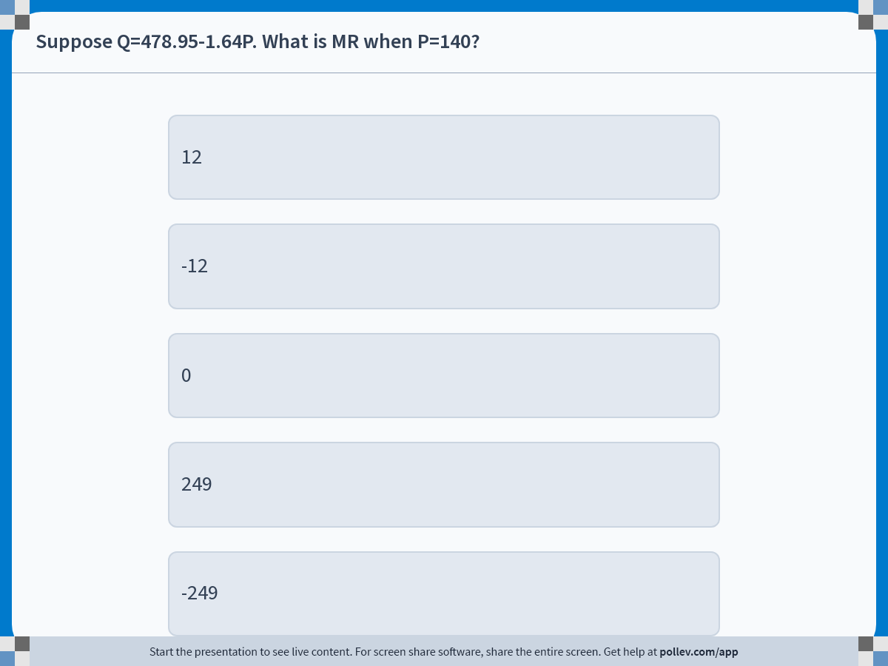
Demand Analysis · Application
Poll: What Is MR at P = 140?
Management 405 · Demand Analysis
19

Slide 51
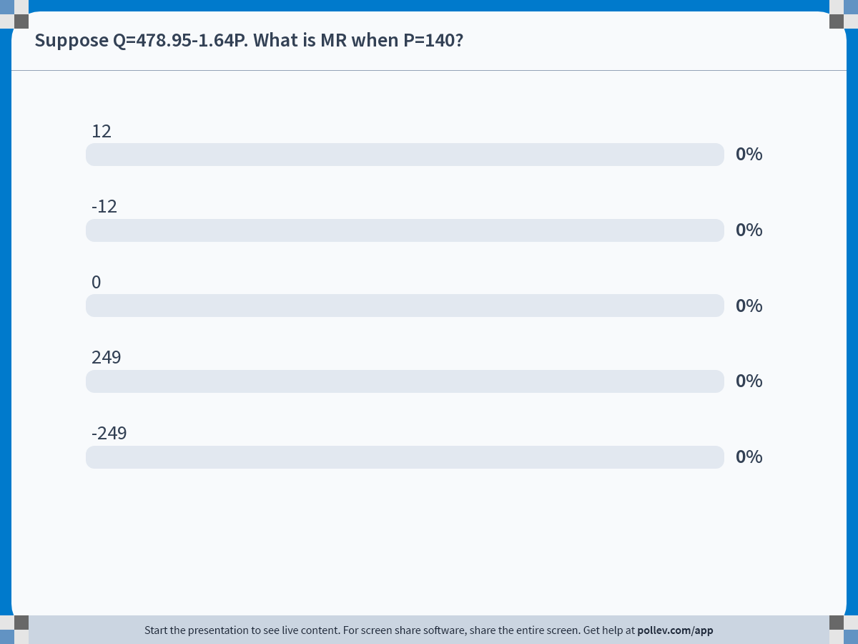
Demand Analysis · Application
Poll Results: Marginal Revenue
Management 405 · Demand Analysis
20

Slide 52
Demand Analysis · Application
Solution: MR
3-step method
1. Inverse demand: P = 292 − (1/1.64) Q
2. Total revenue: TR = 292 Q − (1/1.64) Q²
3. Derivative: MR = 292 − 1.22 Q
MR at P = 140?
P = 140 → Q = 249.35 → MR = −12
Management 405 · Demand Analysis
21

Slide 53
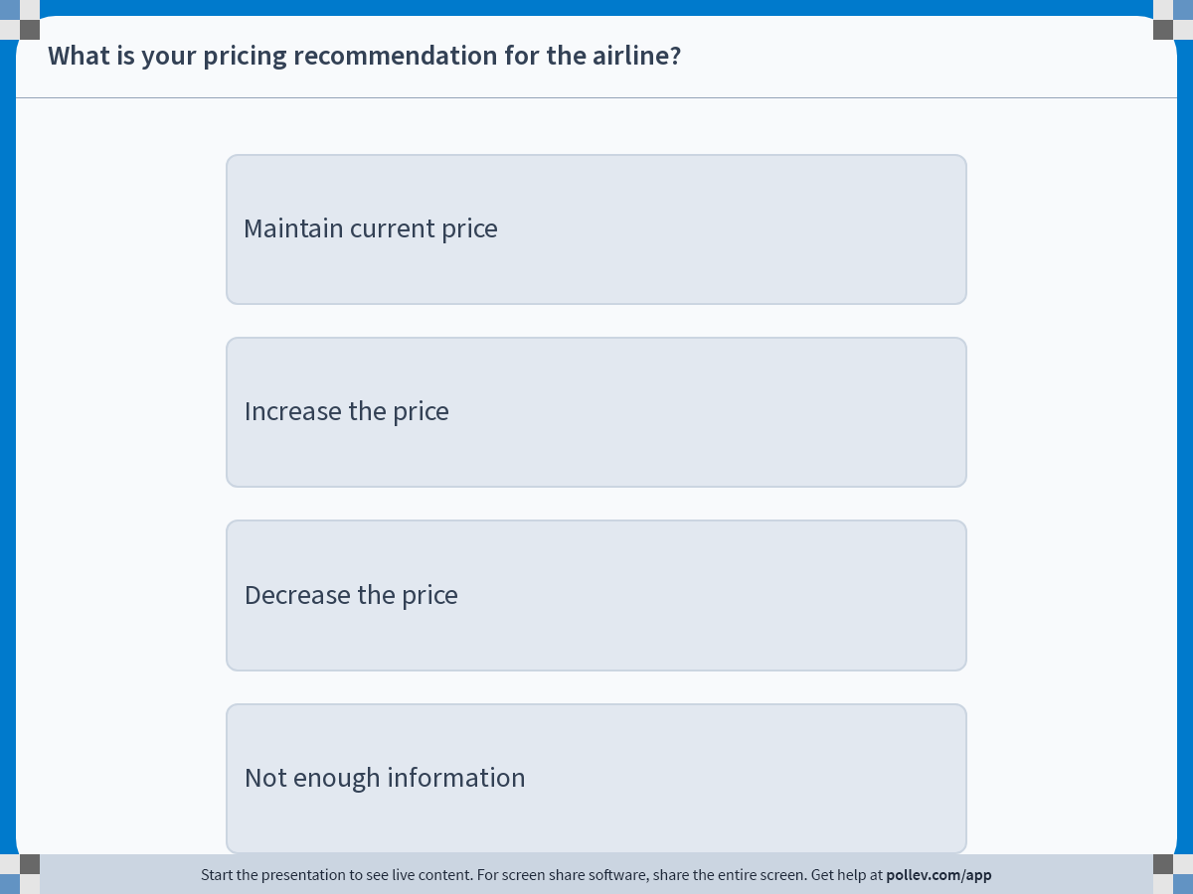
Demand Analysis · Application
Poll: Pricing Recommendation
Management 405 · Demand Analysis
22

Slide 54
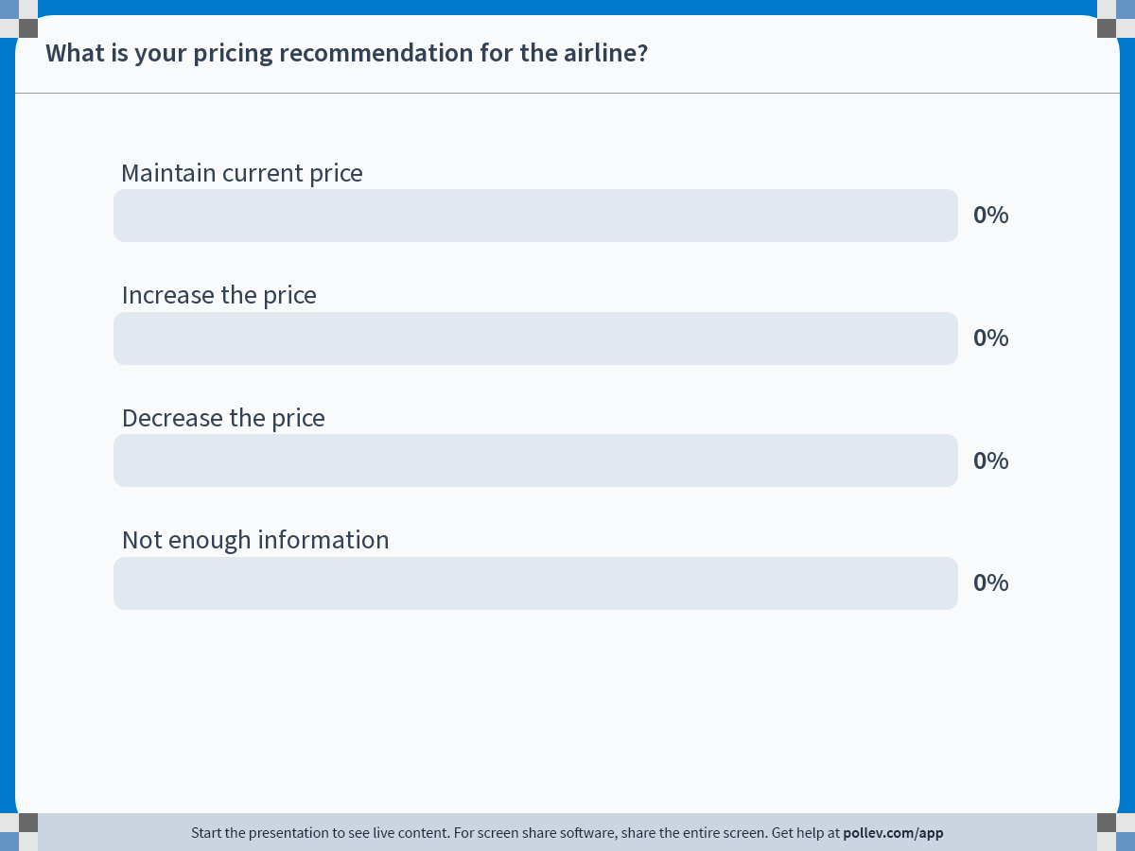
Demand Analysis · Application
Poll Results: Pricing Recommendation
Management 405 · Demand Analysis
23

Slide 55
Demand Analysis · Application
Solution: Raise the Price
P
MR is negative
So you want to sell less
By increasing the price
Elastic
E_{d} = −1
MR
Inelastic
D
Q
Management 405 · Demand Analysis
24

Slide 56
Demand Analysis · Demand Estimation
Issues With Transaction Data: Why Randomization Is Key
Transaction data: prices and quantities evolving over time, across locations and stores
Can we be sure the change in quantity is due to the price change?
Airline example: Aug 2019 sold 135 tickets at $200; Oct 2019 sold 90 at $180
Should we conclude demand slopes upward?
What else changed between those two periods?
Management 405 · Demand Analysis
25

Slide 57


Demand Analysis · Demand Estimation
Correlation Does Not Mean Causation
Example: on average, people who drink two glasses of wine a day are healthier than those who drink none
Causal interpretation: wine improves health (I wish!)
Management 405 · Demand Analysis
26

Slide 58

Demand Analysis · Demand Estimation
Correlation Does Not Mean Causation
Potential problem: some other factor is causing the correlation
Management 405 · Demand Analysis
27

Slide 59
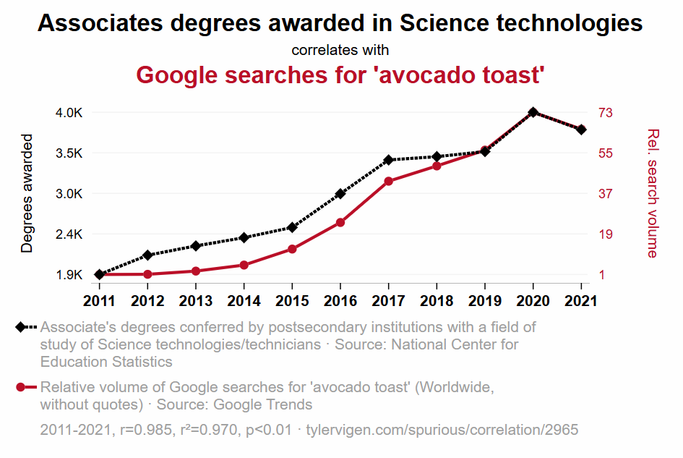
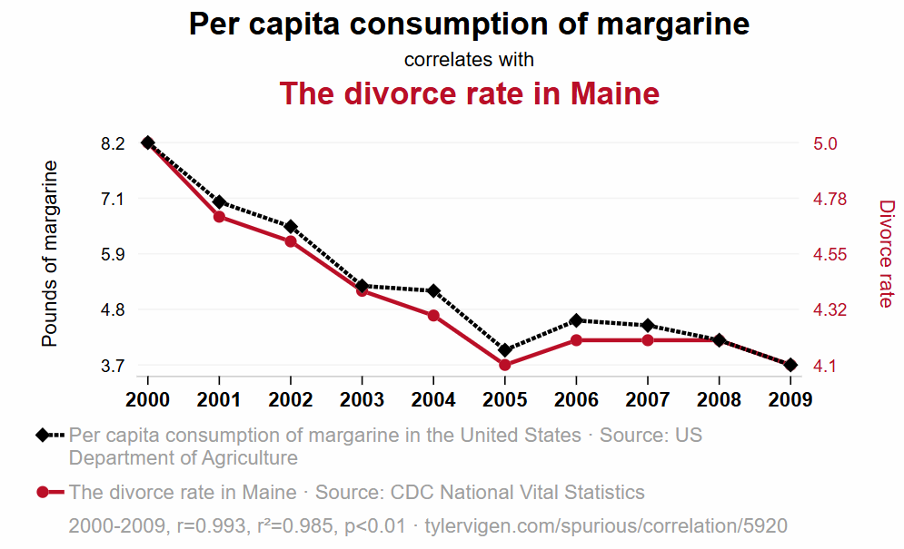
Demand Analysis · Demand Estimation
Spurious Correlations
tylervigen.com/spurious-correlations
Management 405 · Demand Analysis
28

Slide 60
Demand Analysis · Demand Estimation
Why Randomization Is Key
Randomizing prices ensures that “all else is equal” other than the price change
Allows us to estimate the causal effect of price on quantity demanded → the demand curve!
Management 405 · Demand Analysis
29

Slide 61
Demand Analysis · Summary
Demand Analysis Summary
The law of demand
Heterogeneous consumers; diminishing personal value
Elasticities
Own-price elasticity; income and cross-price
Demand and revenue
Own-price elasticity and total revenue; marginal revenue (3-step method)
Demand estimation
Market experimentation and regression analysis
Management 405 · Demand Analysis
30

